Slide 1

STAT7: Discussion Section Week #9
Jacobo Pereira-Pacheco

Slide 2
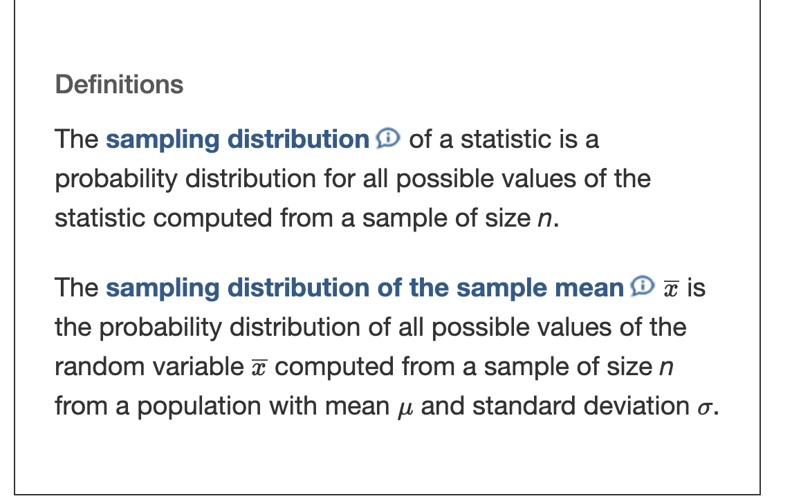
Ch8.1 Distribution of the Sample Mean
Idea behind obtaining the sampling distribution of the sample mean is as follows:
Obtain a simple random sample of size n
Computer the sample mean
Assuming that we are sampling from a finite population, repeat steps 1 and 2 until all distinct simple random samples of size n have been obtained
STAT7 Discussion Section

Slide 3
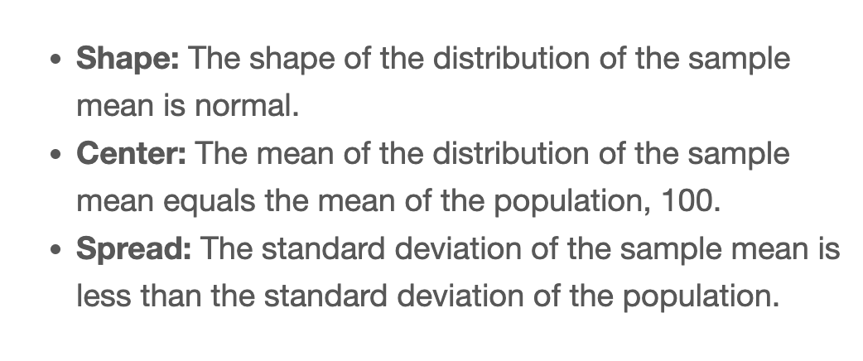
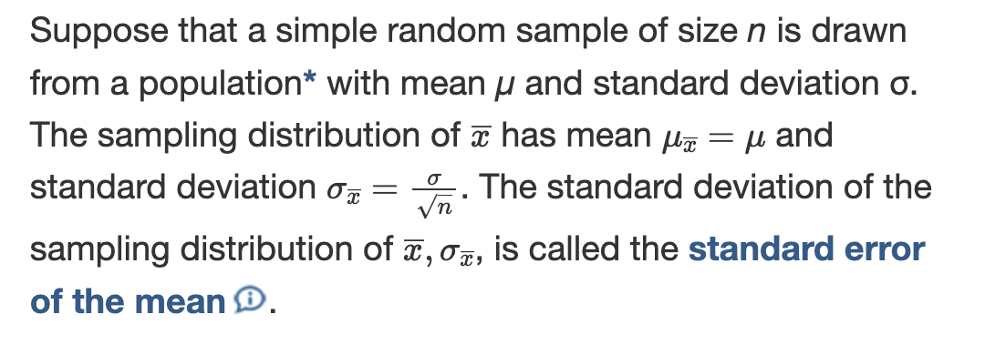
Ch8.1 Distribution of the Sample Mean
STAT7 Discussion Section

Slide 4
Ch8.1 Distribution of the Sample Mean
Objectives
Describe the distribution of the sample mean: normal population
Describe the distribution of the sample mean: nonnormal population
The Central Limit Theorem
Regardless of the shape of the underlying population, the sampling distribution of $\overline{x}$ becomes approximately normal as the sample size, n, increases.
The CLT only has to do with the shape of the distribution of $\overline{x}$, not the center or spread. Regardless of the size of the sample, $μ_{\overline{x}}=μ$ and $σ_{\overline{x}}=\frac{σ}{\sqrt{n}}$
STAT7 Discussion Section

Slide 5
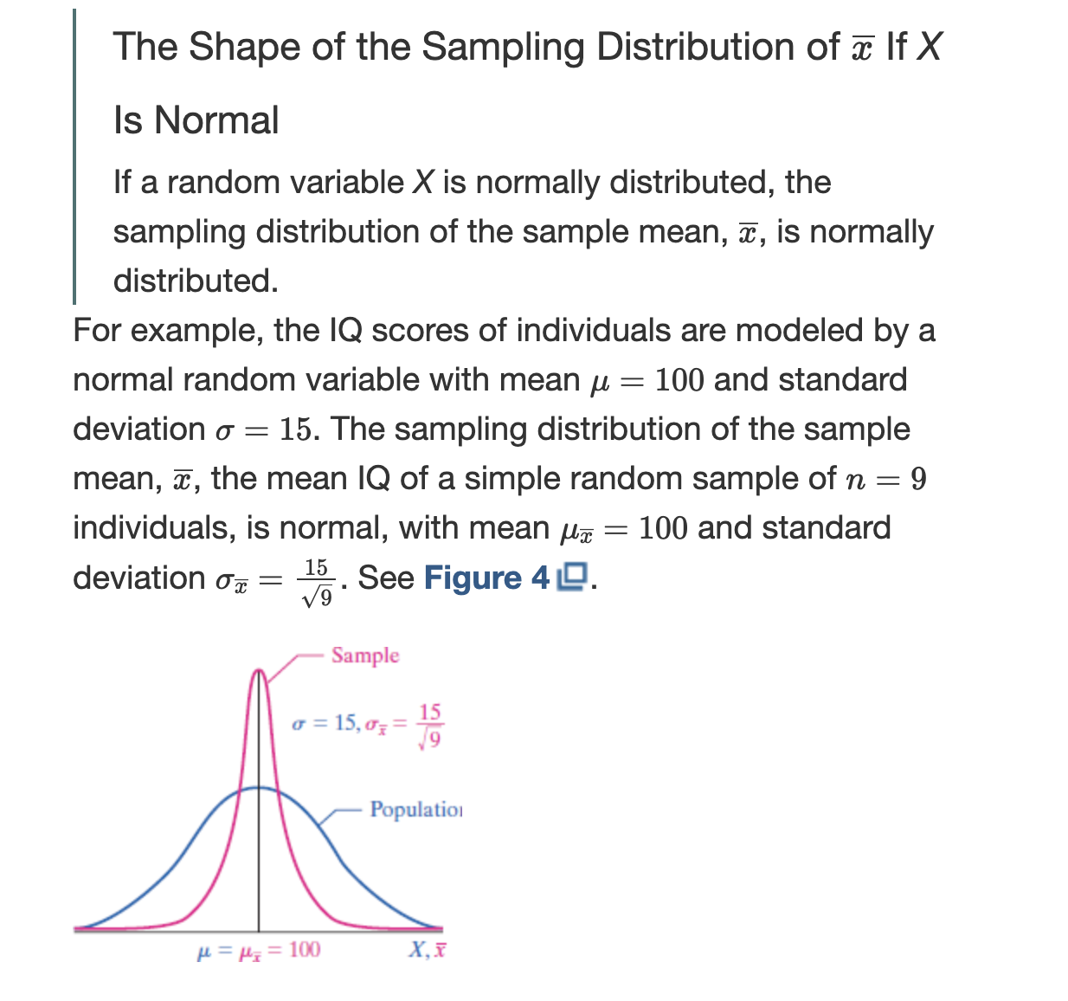
Ch8.1 Distribution of the Sample Mean
STAT7 Discussion Section

Slide 6
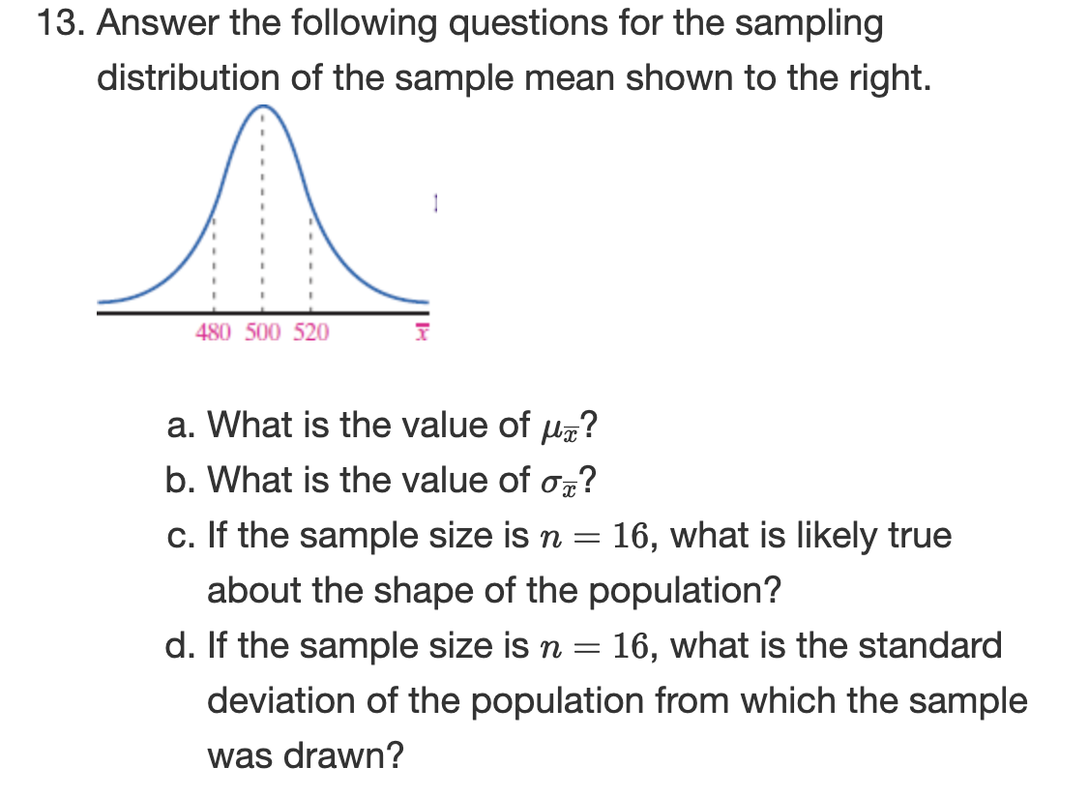
Ch8.1 Distribution of the Sample Mean
STAT7 Discussion Section

Slide 7
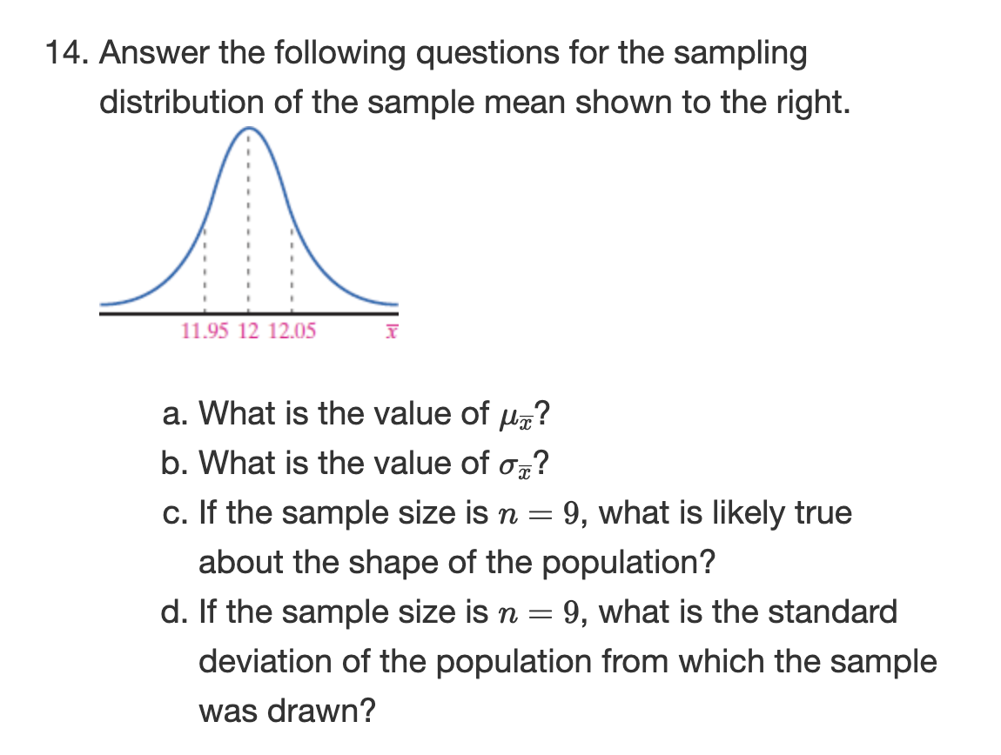
Ch8.1 Distribution of the Sample Mean
STAT7 Discussion Section

Slide 8
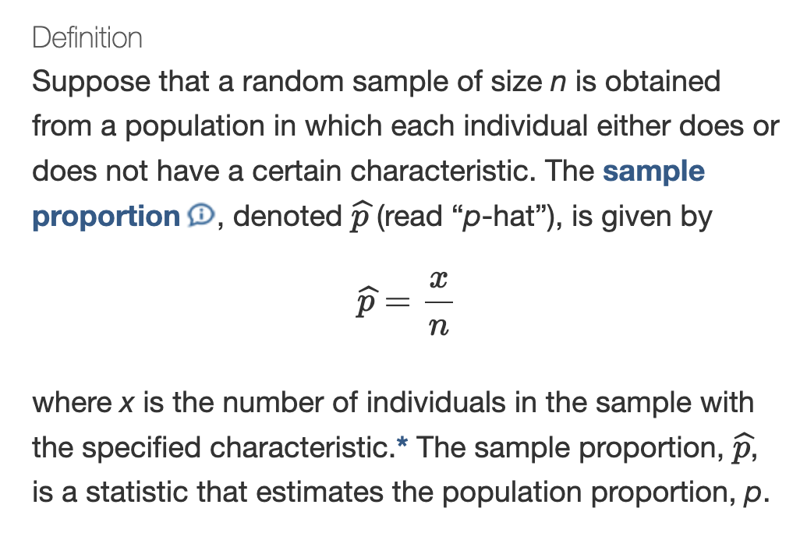
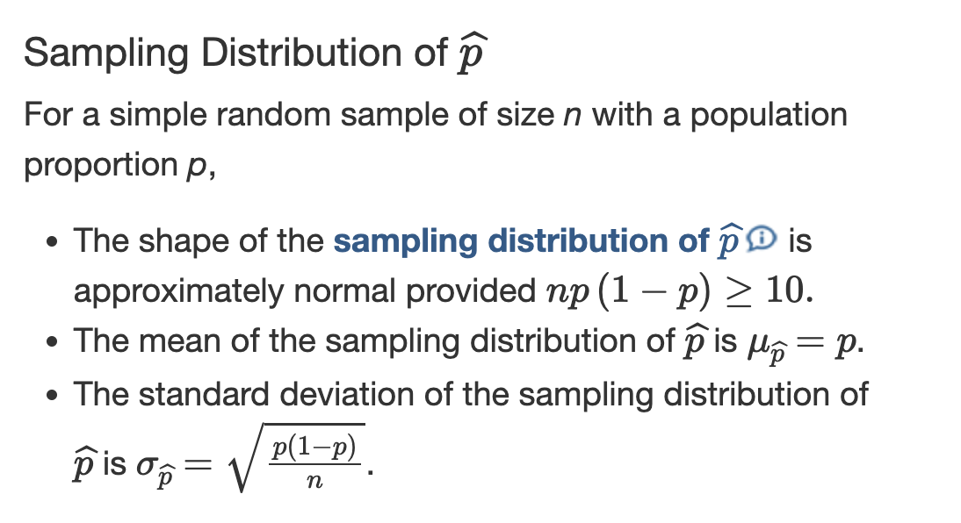
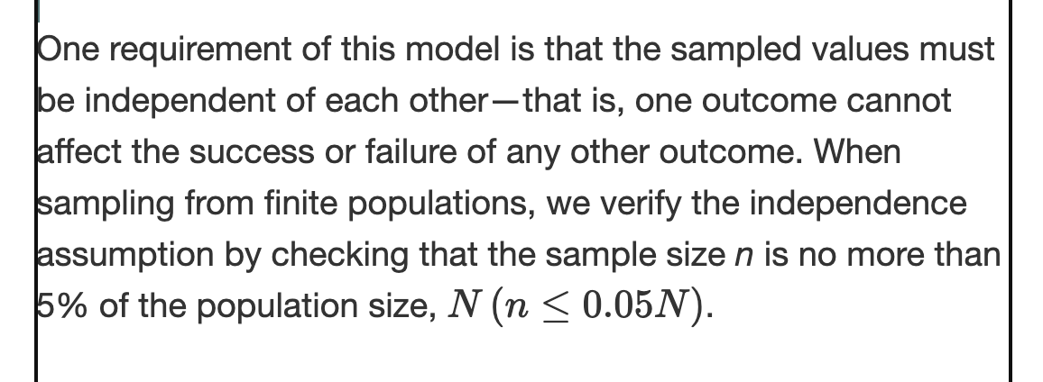
Ch8.2 Distribution of the Sample Proportion
STAT7 Discussion Section

Slide 9
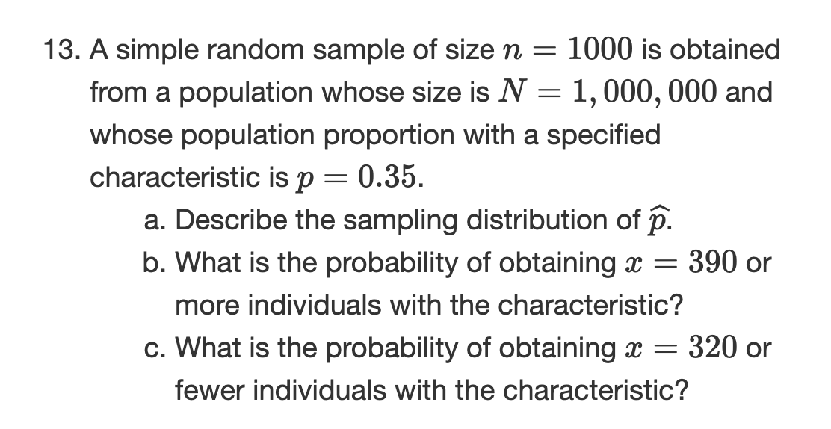
Ch8.2 Distribution of the Sample Proportion
Objectives
Describe the distribution of a sample proportion.
Compute probabilities of a sample proportion.
STAT7 Discussion Section

Slide 10
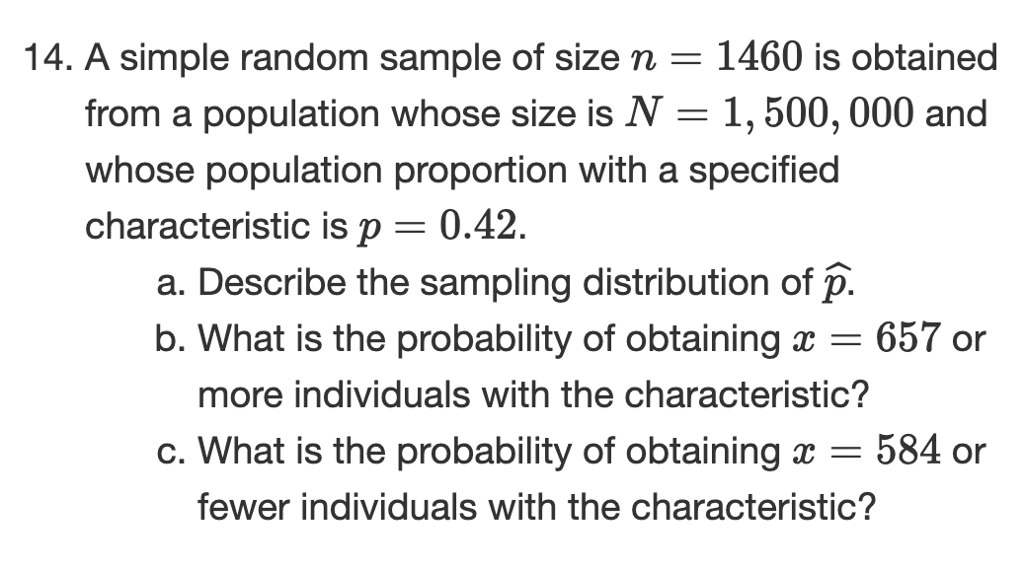
Ch8.2 Distribution of the Sample Proportion
STAT7 Discussion Section

Slide 11
Ch9.1 Estimating a Population Proportion
Objectives
Obtain a point estimate for the population proportion
A point estimate is the value of a statistic that estimates the value of a parameter.
For example: The point estimate for the population proportion is $\overset{̂}{p}=\frac{x}{n}$, where x is the number of individuals in the sample with a specified characteristic and n is the sample size.
Construct and interpret a confidence interval for the population proportion
A confidence interval for an unknown parameter consists of an interval of numbers based on a point estimate.
The level of confidence represents the expected proportion of intervals that will contain the parameter if a large number of different samples is obtained. The level of confidence is denoted $(1-α)⋅100\%$
In layman terms, the confidence interval is a range of numbers. The level of confidence is the proportion of intervals that will contain the unknown parameter if repeated samples are obtained.
Determine the sample size necessary for estimating a population proportion within a specified margin of error.
STAT7 Discussion Section

Slide 12
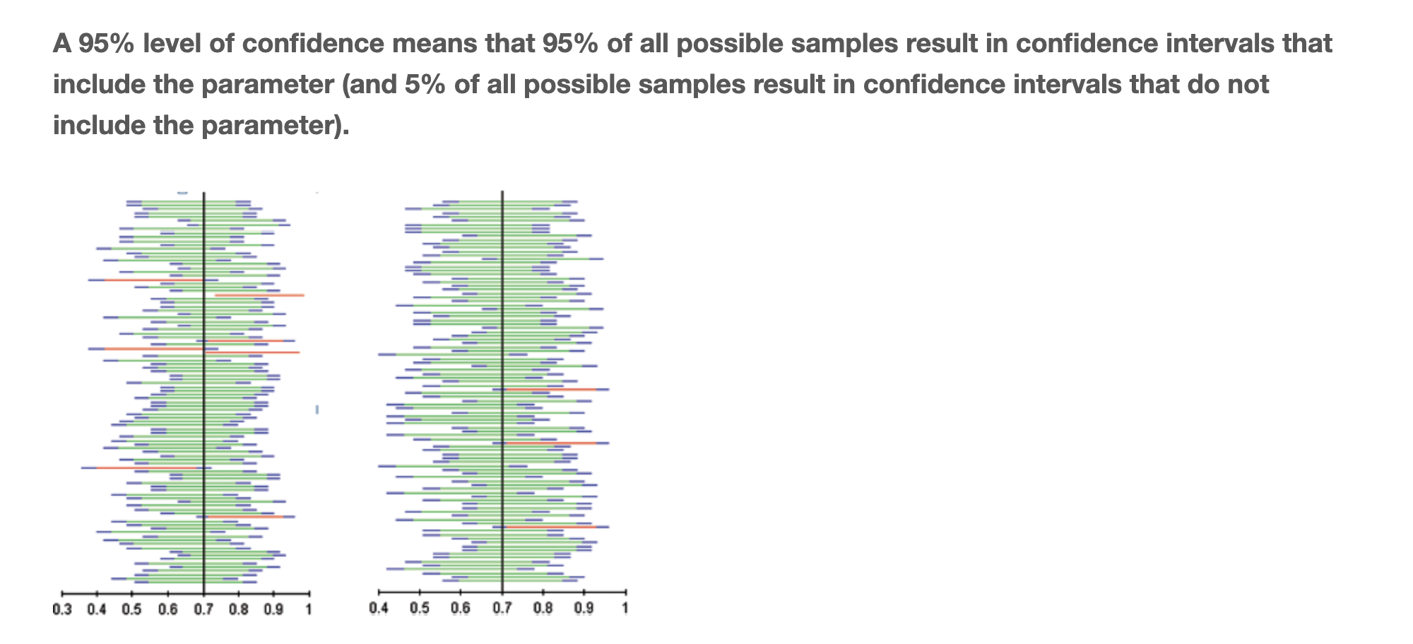
Ch9.1 Estimating a Population Proportion
Interpretation
Confidence Interval
A confidence interval is a range of numbers, such as 22-30. The level of confidence is the proportion of intervals that will contain the unknown parameter if repeated samples are obtained.
For example, a 95% level of confidence ($α=0.05$) implies that if 100 difference confidence intervals are constructed, each based on a different sample from the same population, then we will expect 95 of the intervals to include the parameter and 5 not to include the parameter.
Structural form: $\text{point estimate}±\text{margin of error}$
STAT7 Discussion Section

Slide 13
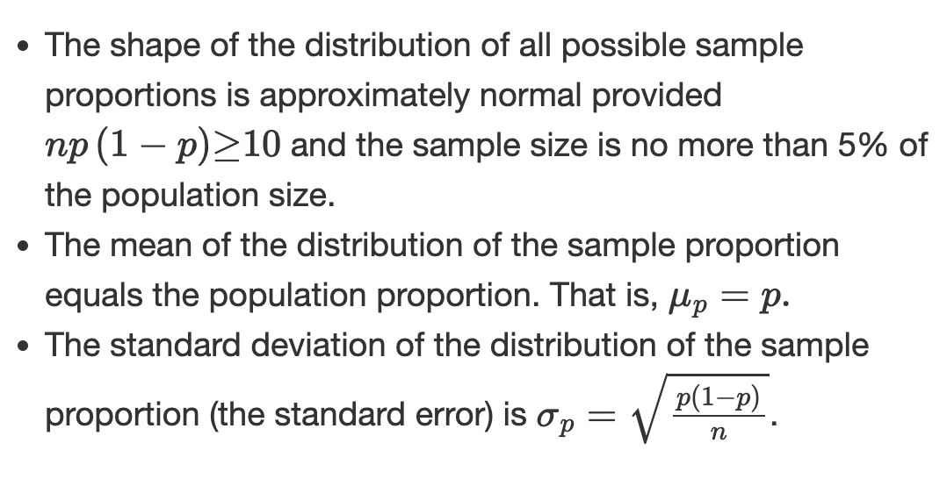
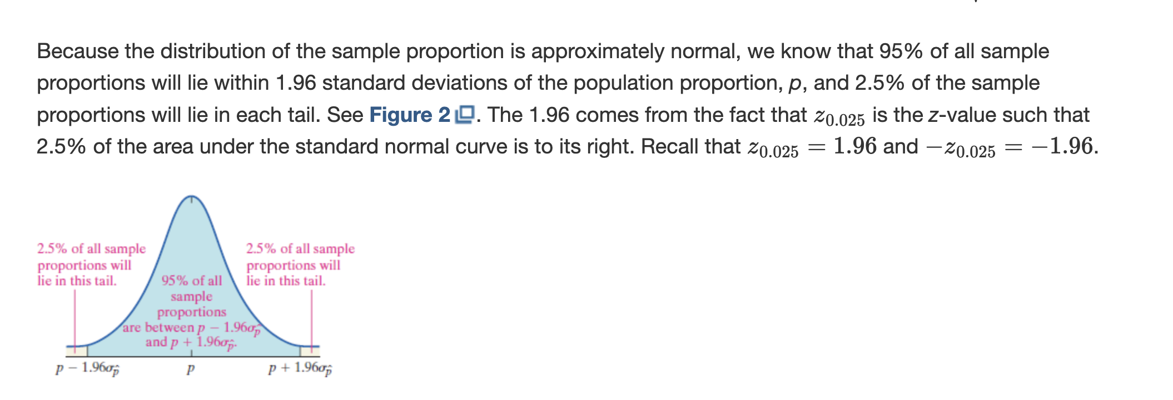
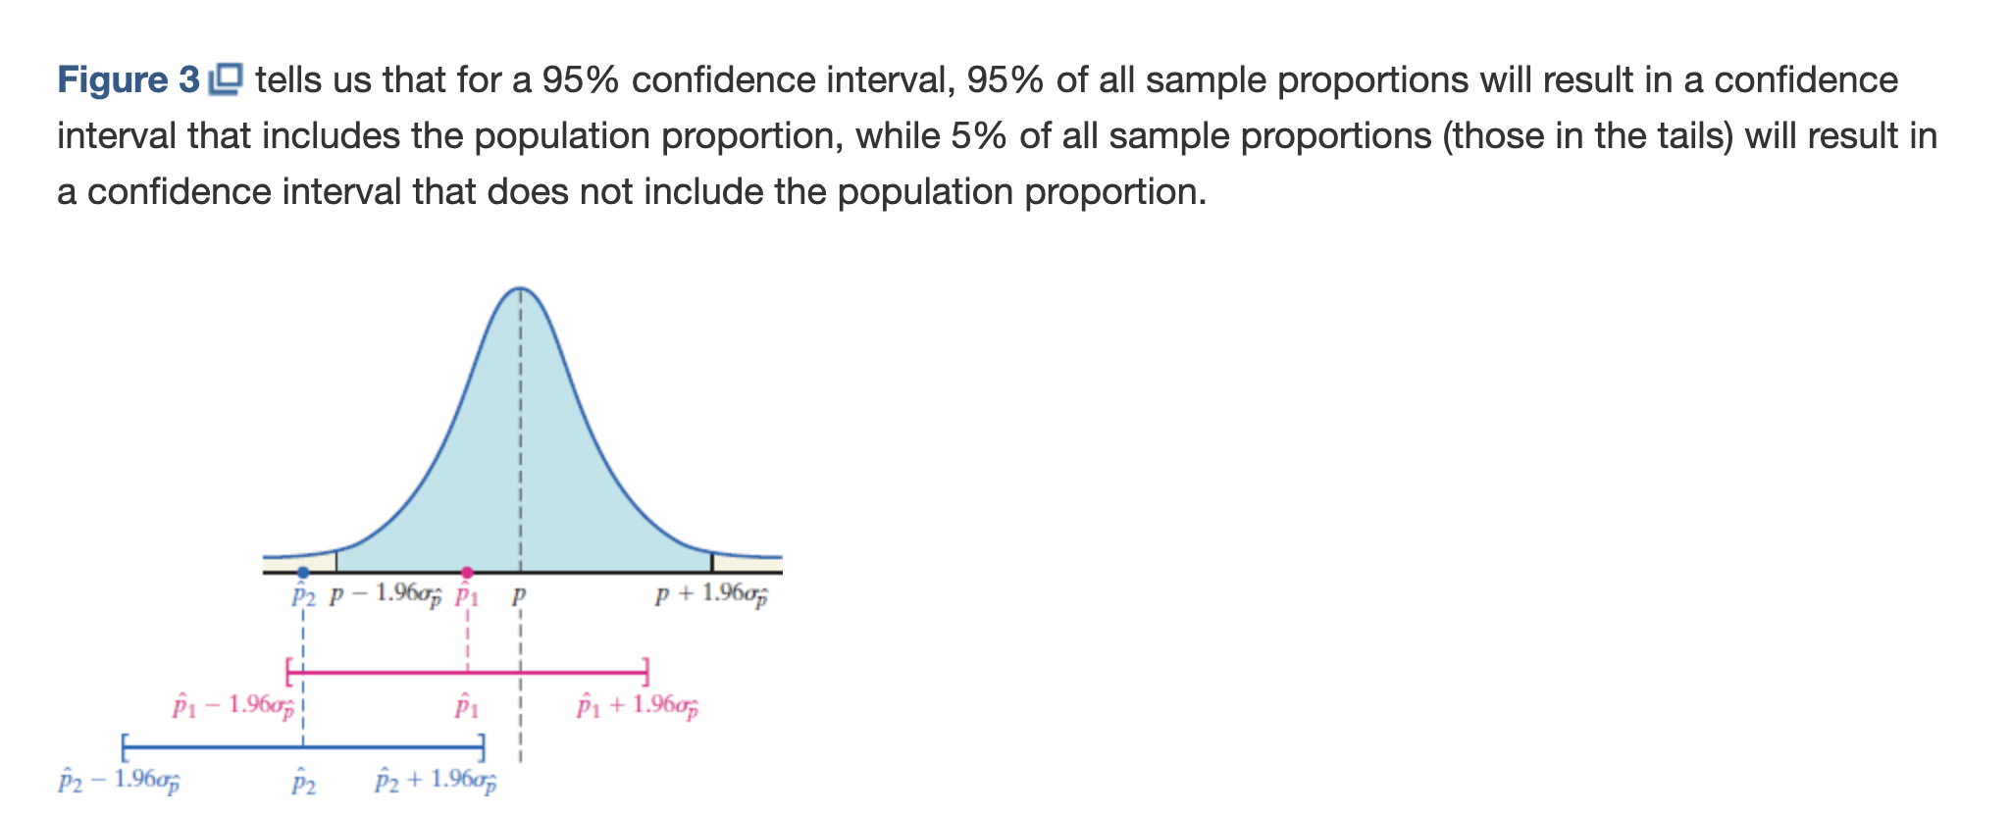
Ch9.1 Estimating a Population Proportion
Now how to construct confidence intervals?
Well what do we know?
STAT7 Discussion Section

Slide 14
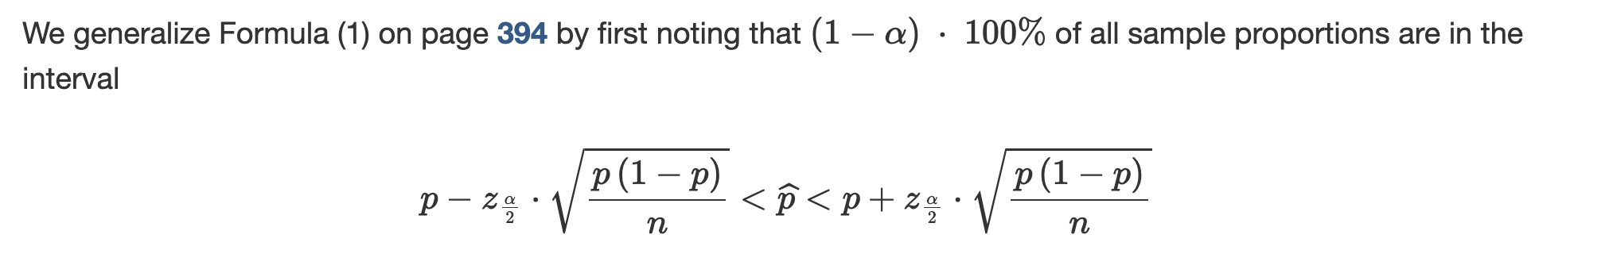
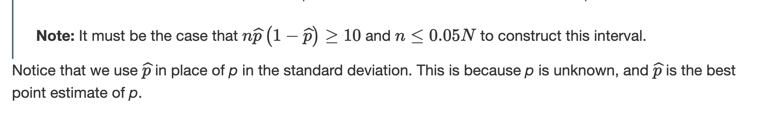
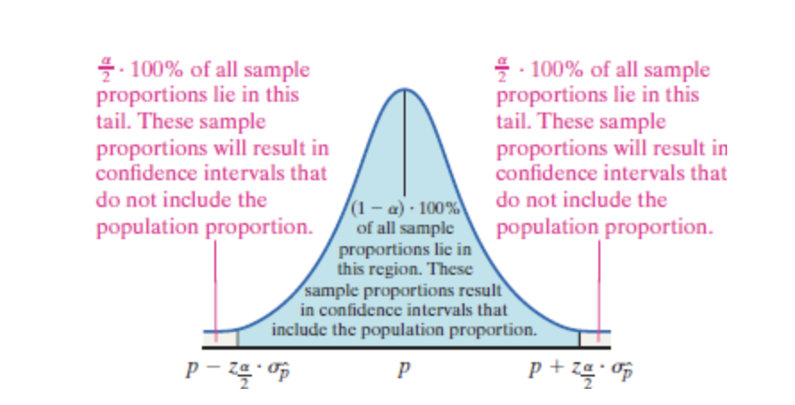
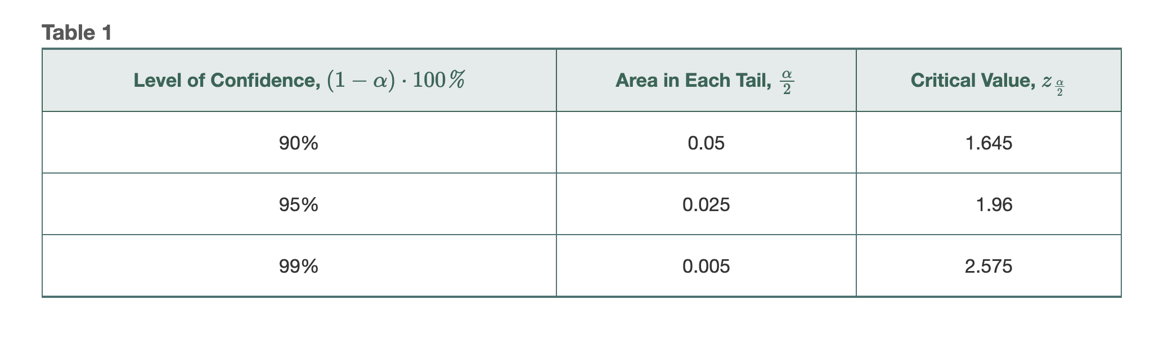
Ch9.1 Estimating a Population Proportion
STAT7 Discussion Section

Slide 15
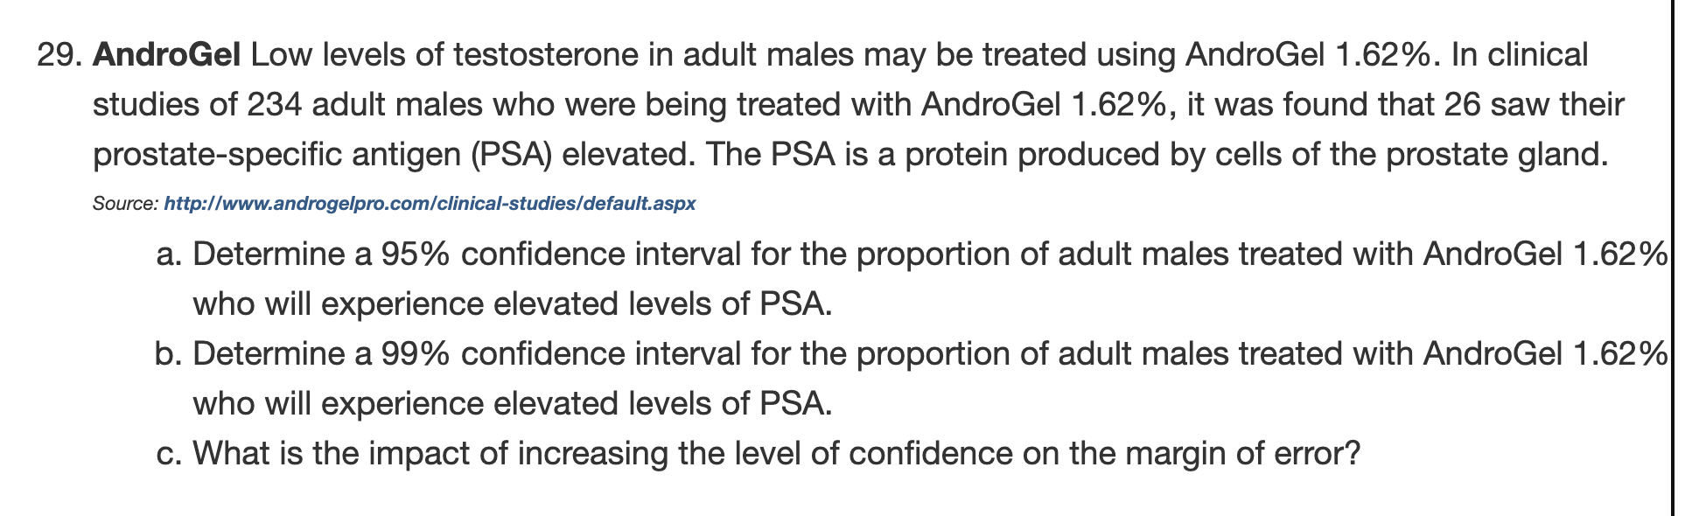
Ch9.1 Estimating a Population Proportion
STAT7 Discussion Section

Slide 16
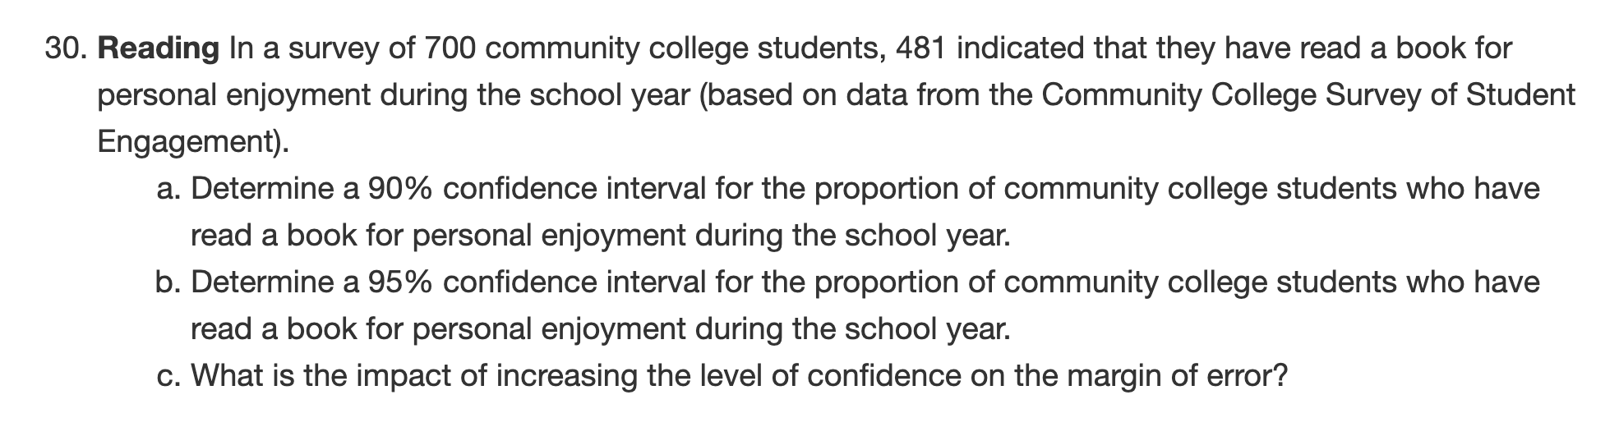
Ch9.1 Estimating a Population Proportion
STAT7 Discussion Section

Slide 17
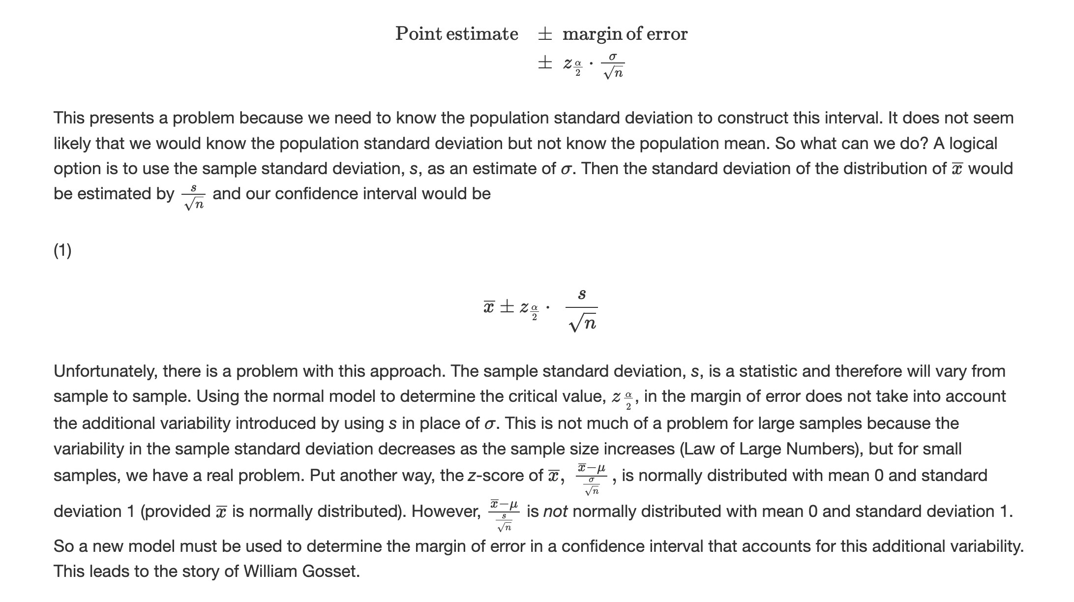
Ch9.2 Estimating a Population Mean
Objectives
Obtain a point estimate for the population mean
State properties of Student’s t-distribution
Determine the t-values
Construct and interpret a confidence interval for a population mean
Determine the sample size needed to estimate a population mean with a specified margin of error
STAT7 Discussion Section

Slide 18
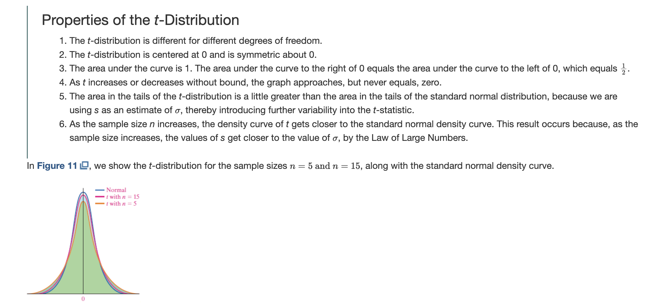
Ch9.2 Estimating a Population Mean
Objectives
Obtain a point estimate for the population mean
State properties of Student’s t-distribution
Determine the t-values
Construct and interpret a confidence interval for a population mean
Determine the sample size needed to estimate a population mean with a specified margin of error
STAT7 Discussion Section

Slide 19
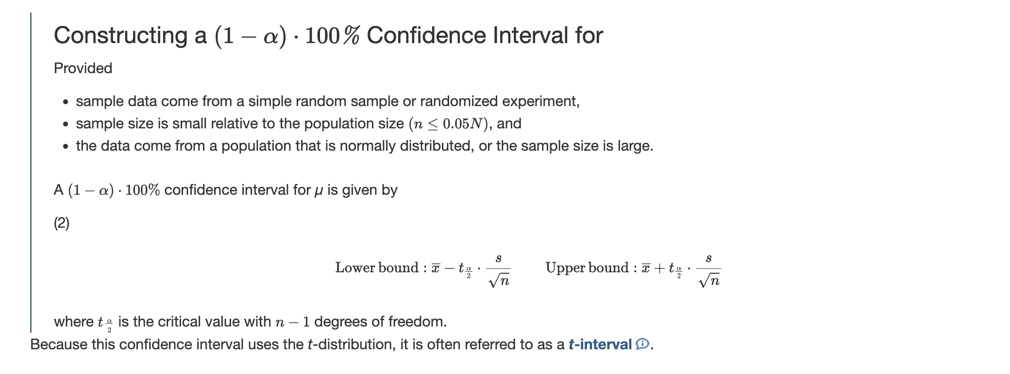
Ch9.2 Estimating a Population Mean
STAT7 Discussion Section

Slide 20
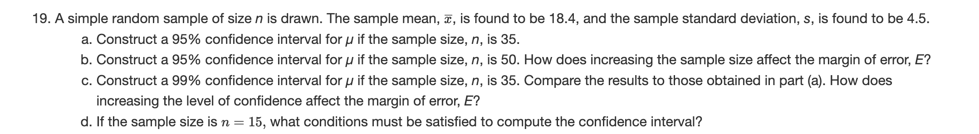
Ch9.2 Estimating a Population Mean
STAT7 Discussion Section

Slide 21
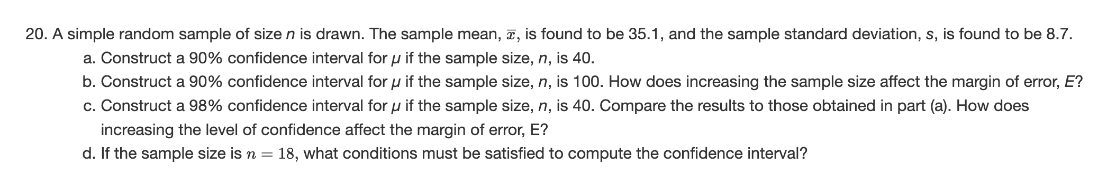
Ch9.2 Estimating a Population Mean
STAT7 Discussion Section

Slide 22
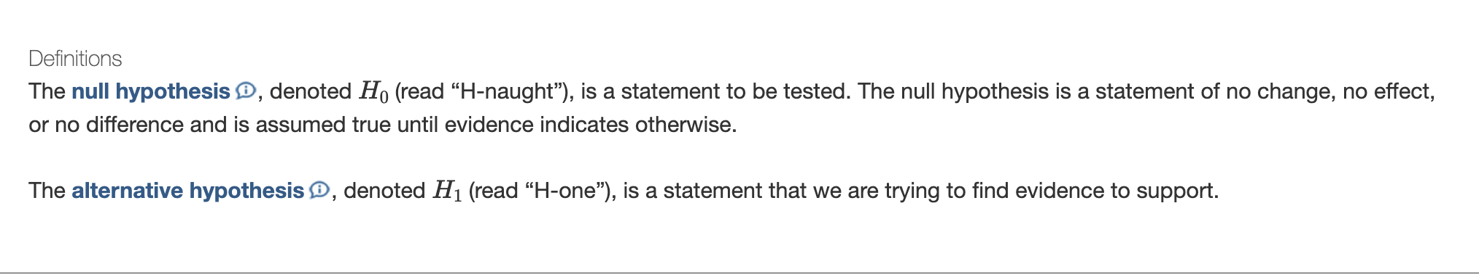
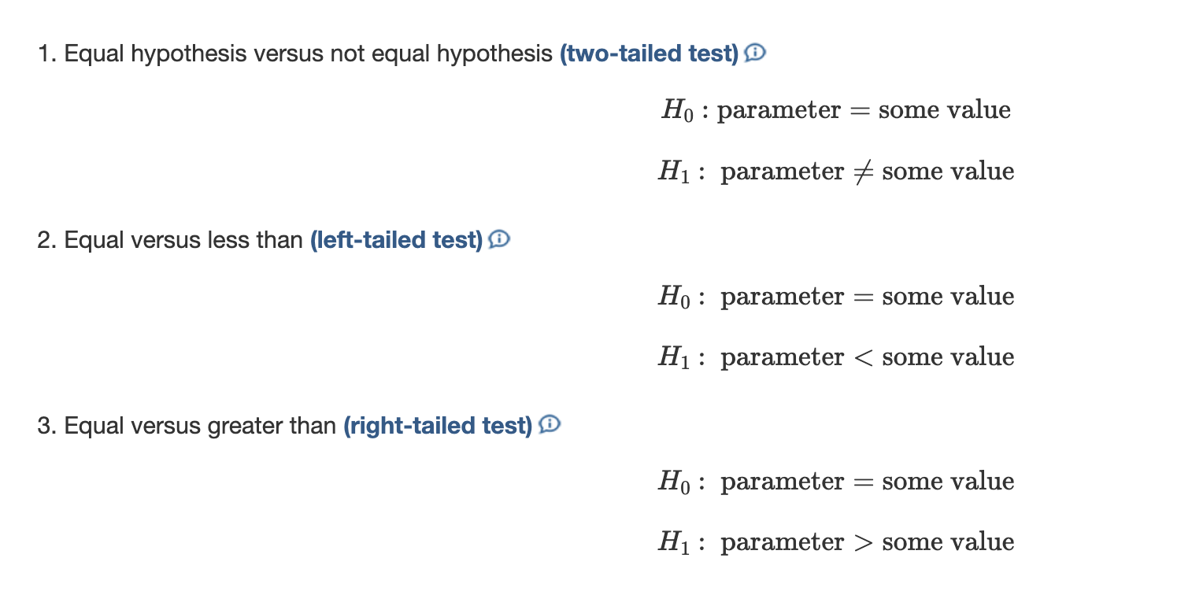
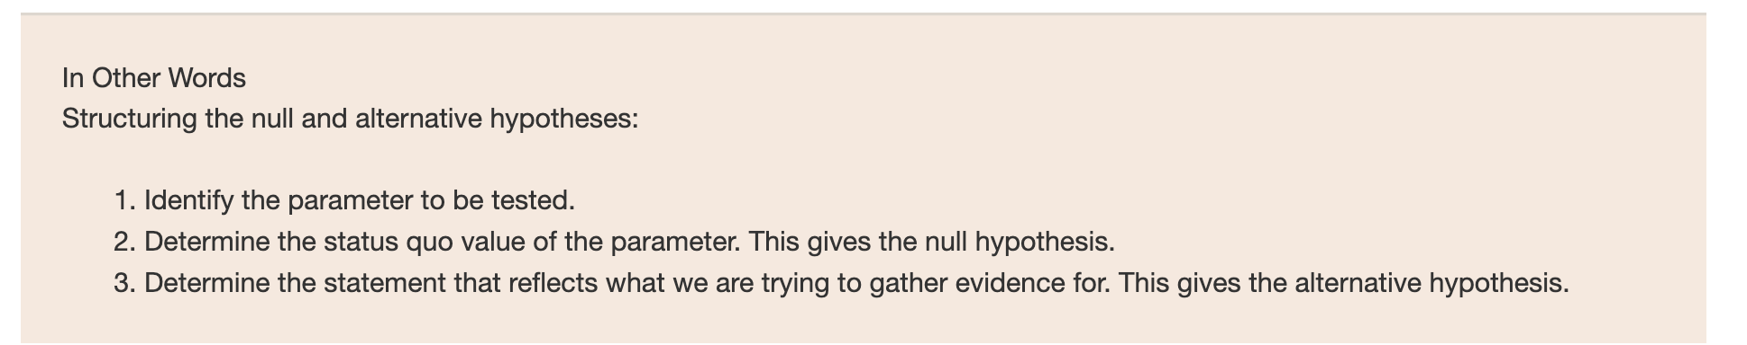
Ch10.1 The Language of Hypothesis Testing
Objectives
Determine the null and alternative hypothesis
Explain Type I and Type II errors
State conclusions to hypothesis tests
STAT7 Discussion Section

Slide 23
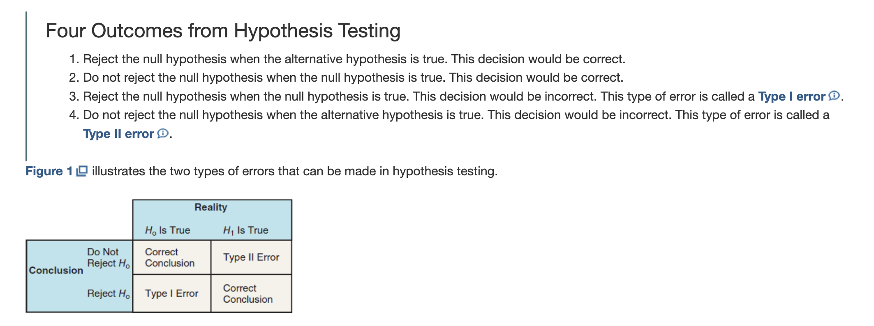
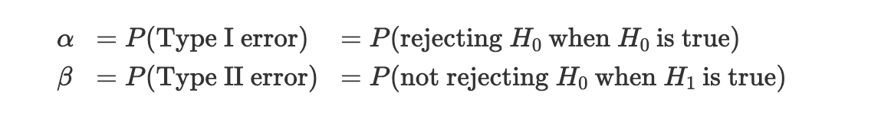
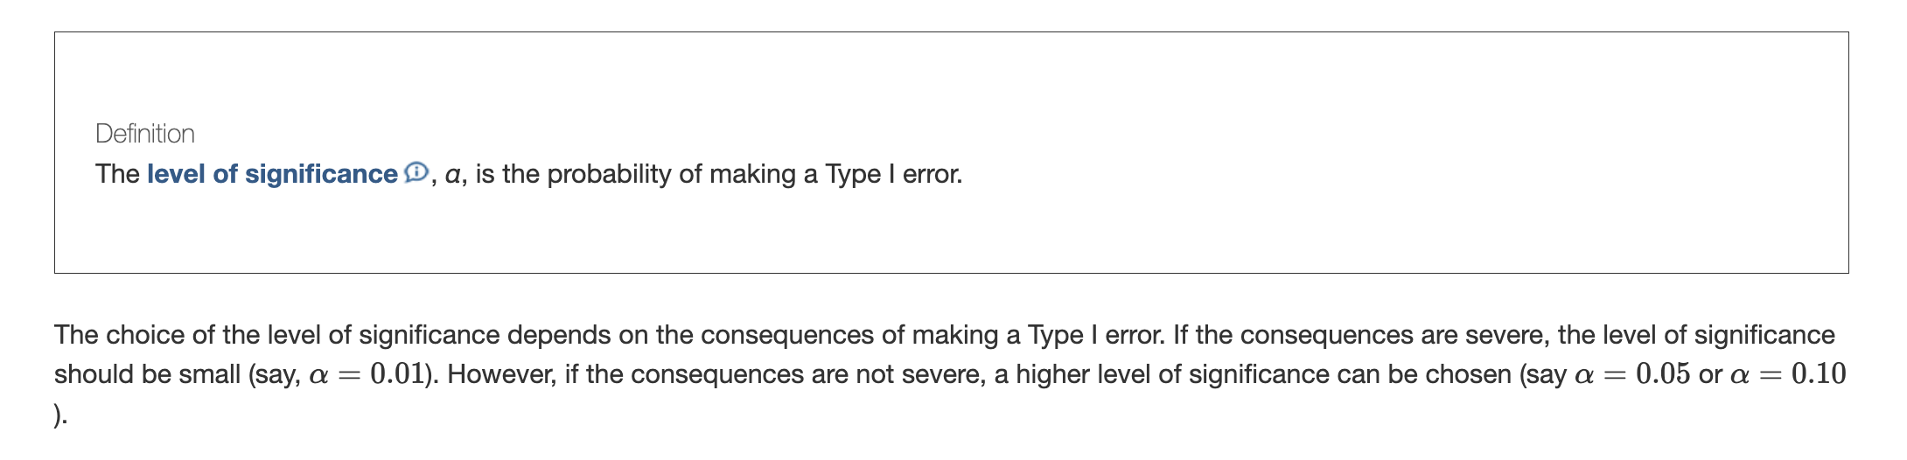
Ch10.1 The Language of Hypothesis Testing
STAT7 Discussion Section

Slide 24
Ch10.1 The Language of Hypothesis Testing
STAT7 Discussion Section

Slide 25
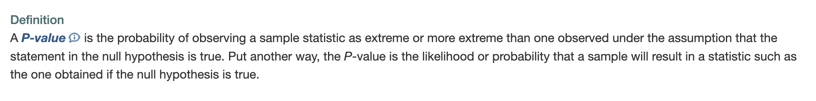
Ch10.2 Hypothesis Tests for a Population Proportion
Objectives
Explain the logic of hypothesis testing
Test hypotheses about a population proportion
Test hypotheses about a population proportion using the binomial probability distribution
STAT7 Discussion Section

Slide 26
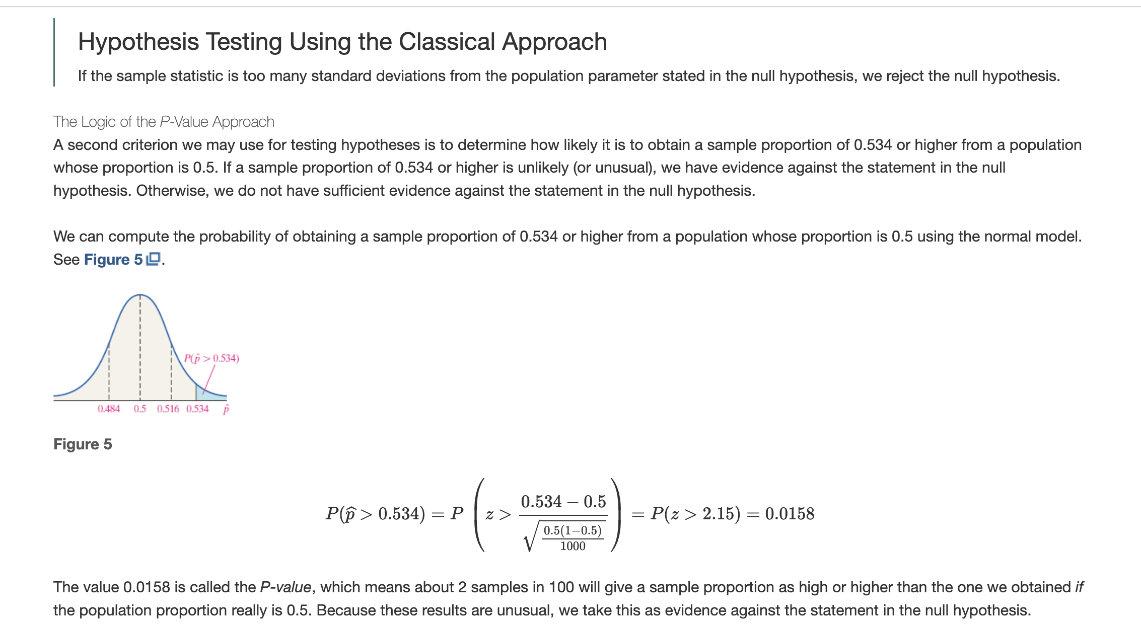
Ch10.2 Hypothesis Tests for a Population Proportion
STAT7 Discussion Section

Slide 27
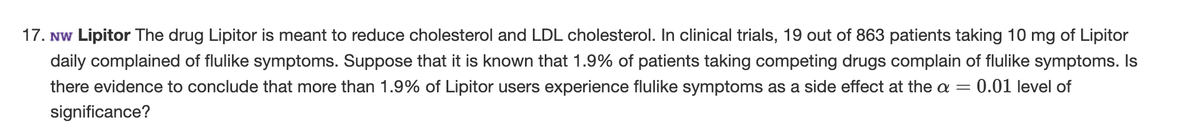
Ch10.2 Hypothesis Tests for a Population Proportion
STAT7 Discussion Section

